Slide 1







Data Driven Documents
Introduction to visualizing data with d3.js

Slide 2
My Team (Group 1)
Nishita Aishwarya 2018450001
Hammad Ansari 2018450002
Maulika Arekar 2018450003
Diksha Bandagale 2018450004

Slide 3
Outline
What is D3? And it’s architecture
Getting Started
How D3 works
What we were able to build with D3

Slide 4


What is D3?
Created by
D3.js is a JavaScript library for manipulating documents based on data
D3 helps you bring data to life using HTML, SVG, and CSS
D3.js is extremely fast, responsive and supports large data sets too for creating dynamic animations in web browsers.
The collection of useful coding components & plugins make d3 codes reusable.
In 2011

Slide 5
D3
Data - provided by you
Driven - d3 connects data to documents
Documents - builds web based documents

Slide 6

Architecture
Data {JSON, CSV}
Low - Level
Libraries
UI

Slide 7
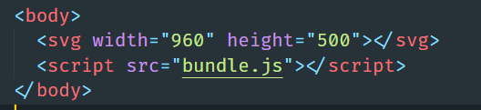
Getting Started
Import library
Create a simple SVG vector and link JS file

Slide 8
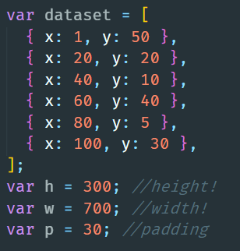
How D3 works
Setting Up Our Variables:

Slide 9
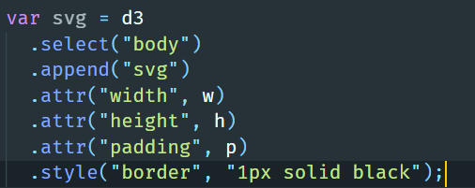
Creating an SVG using .select()

Slide 10
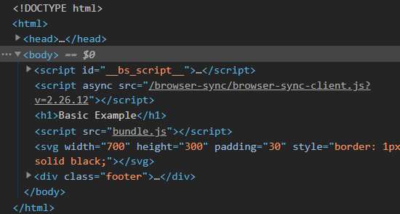
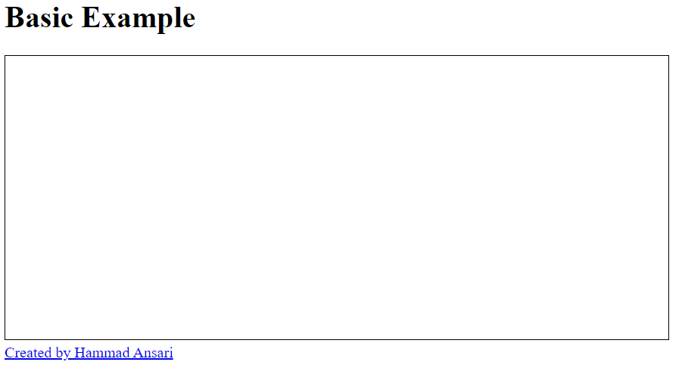

Slide 11
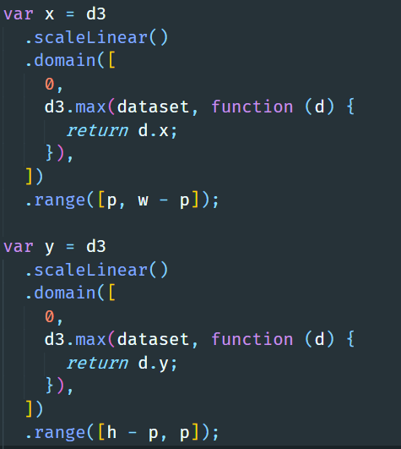
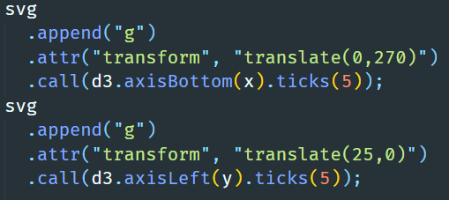
Axes and Scale
axis() and scale()

Slide 12
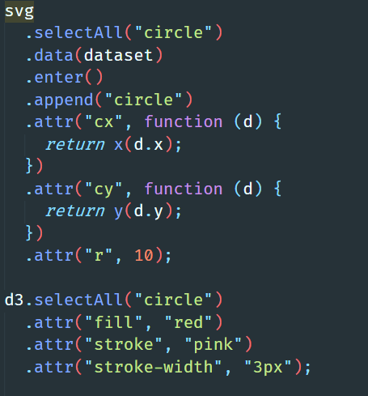
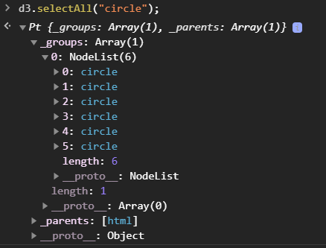
.selectAll()

Slide 13
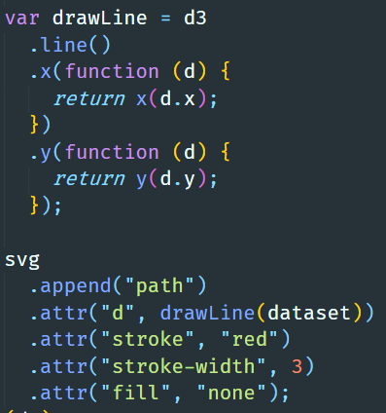
Drawing a line and setting up a path using line()

Slide 14
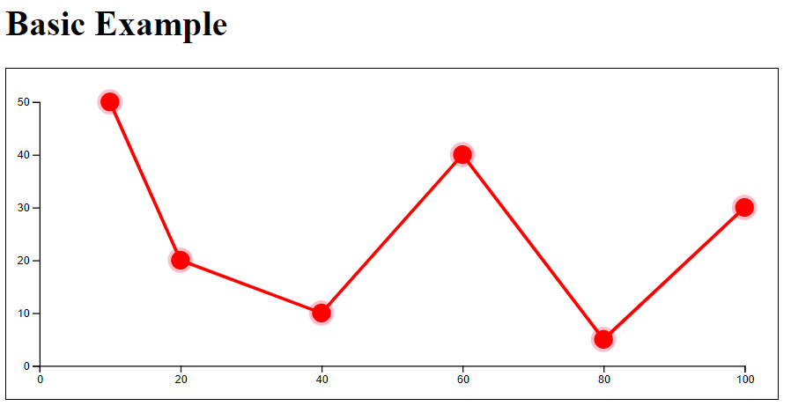

Slide 15
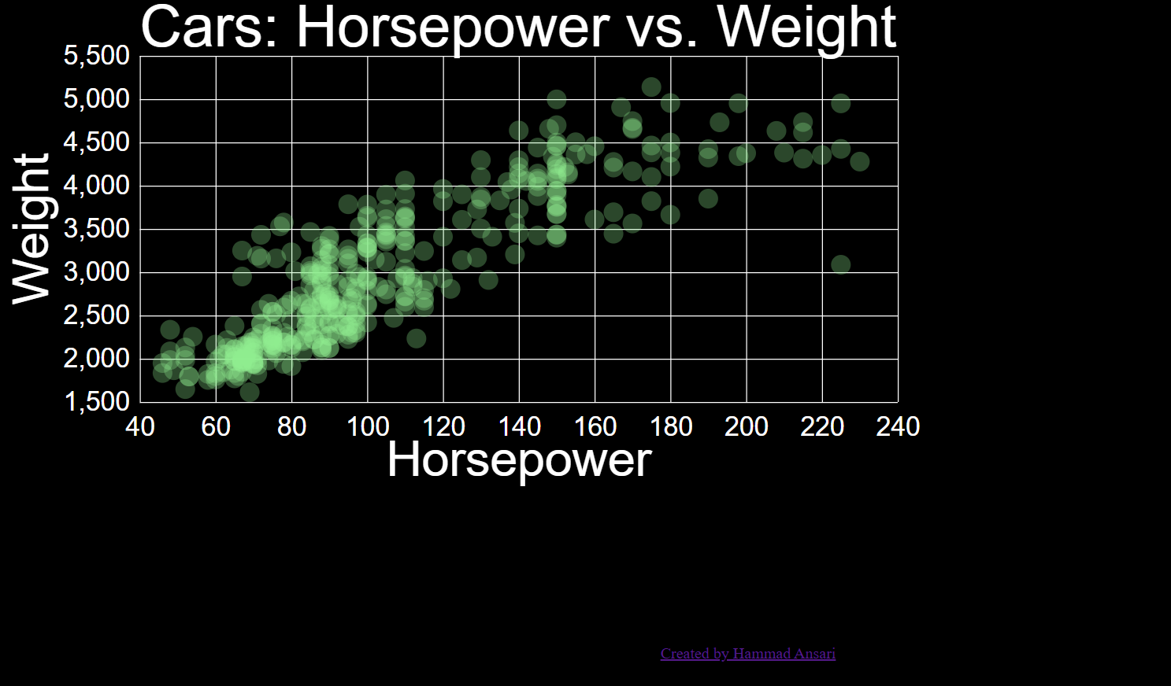
What we have build?
Scatter plot on Cars dataset
Tree Visualization on World Countries Dataset

Slide 16
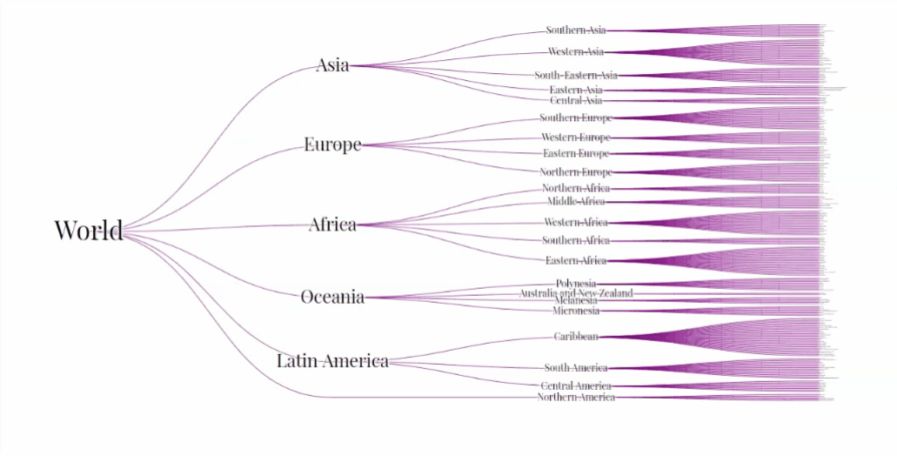

Slide 17
Resources
https://d3js.org
https://github.com/d3/d3
https://observablehq.com/@d3/gallery
https://github.com/fruxc/d3js

Slide 18
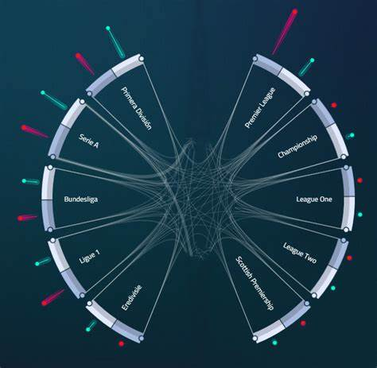
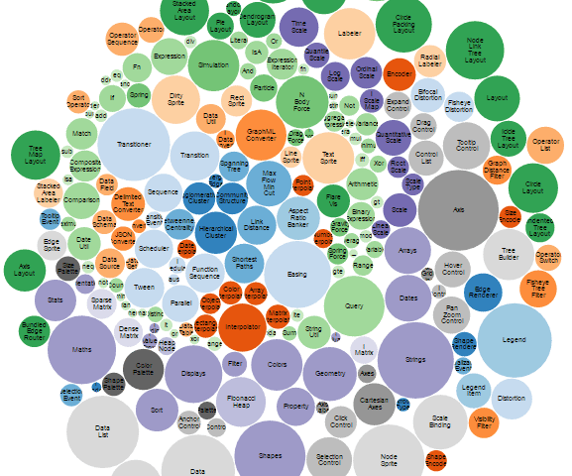
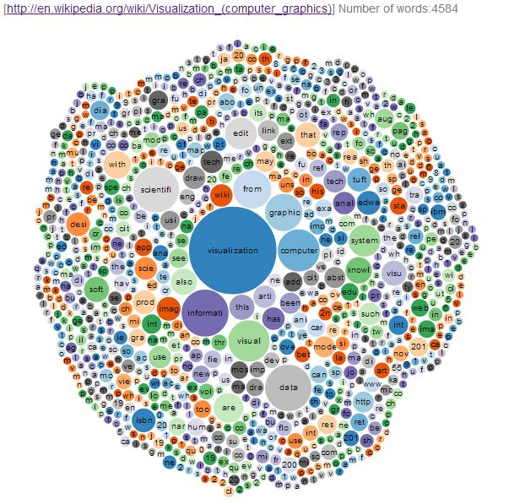

Thanks!
Any questions?

